Slide 1
DOMESTIC WASTE MANAGEMENT
PIP4004 UNIVERSITY PROJECT
Review-2
Batch Number: CSE-200
Under the Supervision of,
Dr. Chandra Sekhar M Professor
School of Computer Science and Engineering Presidency University
Name of the Program: B.Tech
Name of the HoD: Dr. Asif Mohamed H B Name of the Program Project Coordinator:
Name of the School Project Coordinators: Dr. Sampath A K / Dr. Abdul Khadar A / Mr. Md Ziaur Rahman
Roll Number | Student Name
20211CSE0196 20211CSE0230 20211CSE0550 20211CSE0140 | Eshaan Khurana Charan Kumar S Gagana Sindhu B M Hisham

Slide 2
Introduction
Domestic waste management is a growing environmental concern due to the increasing volume of waste generated by households. Improper waste disposal leads to pollution, health hazards, and depletion of natural resources. Effective waste management strategies are essential to promote sustainability, minimize landfill use, and encourage recycling. This project explores modern solutions to improve waste segregation, collection, and recycling using smart technologies and community-driven approaches.

Slide 3
Problem statement
Many urban and rural areas struggle with inefficient domestic waste management due to poor segregation at the source, inadequate waste collection infrastructure, and over-reliance on landfills. Traditional waste disposal methods contribute to environmental pollution, greenhouse gas emissions, and public health risks. The absence of smart waste management solutions further exacerbates the problem, necessitating innovative interventions to enhance waste segregation and treatment.

Slide 4
Objectives
To analyze domestic waste composition and generation trends.
To evaluate existing waste collection and segregation methods.
To identify challenges and inefficiencies in current waste management
systems.
To propose a sustainable and technology-driven waste management model.
To explore policy recommendations for improved waste handling and
disposal.

Slide 5
Literature Review
Recent Studies:
– IoT-based waste tracking: Smart bins & optimized collection (Rodriguez et al.,
2024).
– AI-powered waste segregation: Automation in sorting systems (Kumar & Sharma,
2023).
– Impact of public awareness campaigns on waste reduction (Gupta & Mohan,
2024).
• Hyderabad Waste Management Project (HWMP):
– Integrated Hazardous Waste Management: HWMP, a subsidiary of Re
Sustainability Limited, operates a Treatment, Storage, and Disposal Facility
(TSDF) established in 2001 in Medchal-Malkajgiri, Telangana
(hwmp.resustainability.com).

Slide 6
Existing Methods and Their Drawbacks
Manual Waste Segregation: Relies on individual effort, leading to
inconsistent sorting and contamination of recyclables.
Traditional Waste Collection: Inefficient collection schedules result in overflow and illegal dumping.
Landfill Dependency: Excessive landfill use leads to environmental
degradation and methane emissions.
High-Cost Advanced Technologies: Waste-to-energy plants and advanced recycling facilities require substantial investments, limiting accessibility in developing regions.

Slide 7
Proposed Architecture
To evaluate domestic waste composition and trends.
To identify inefficiencies in existing waste disposal methods.
To propose a smart, data-driven waste management model.
To promote a healthy and sustainable means of waste disposal by the concept
of gamification.

Slide 8
Methodology/Modules
Waste Segregation Module: Encourages source-level segregation by providing educational programs and necessary infrastructure, such as labeled bins for organic, recyclable, and non-recyclable waste.
Smart Collection Module: Integrates IoT-enabled smart bins, real-time tracking of waste collection vehicles, and an optimized scheduling system to ensure timely and efficient waste collection.
Recycling and Composting Module: Implements AI-driven waste sorting systems and decentralized composting units to maximize resource recovery and reduce landfill waste.

Slide 9
Hardware/Software Components
Programming Language: Python(React),HTML/CSS
Cloud Storage: For real-time data storage and accessibility

Slide 10
Project Timeline
A structured timeline is essential for efficient project execution. The
implementation phases include:
Phase 0: Research and requirement gathering
Phase 1: System design and architecture planning
Phase 2: Development and testing of smart collection modules
Phase 3: Deployment and performance evaluation

Slide 11
Expected Outcomes
Improved waste segregation at the source, leading to higher recycling rates
and reduced landfill dependency.
Enhanced efficiency of waste collection through IoT-enabled tracking and optimized routes.
Increased adoption of sustainable waste treatment methods, such as
composting and waste-to-energy conversion.
Reduced environmental pollution and greenhouse gas emissions through better landfill management.

Slide 12
Conclusion
Efficient domestic waste management is crucial for sustainability and public health. This project proposes an integrated approach combining smart technologies, policy interventions, and community participation to address existing challenges. The adoption of IoT, AI-powered sorting, and optimized waste collection can significantly improve recycling rates and reduce environmental pollution. Future research should focus on scalable models that can be implemented across diverse regions.

Slide 13
Github Link
Github Link
https://github.com/Delhiwala/Domestic-Waste-Management

Slide 14
References
Brown, T., et al. (2018). "Recycling behavior and its impact on waste
management."
Chen, L., et al. (2020). "Environmental impacts of landfill waste disposal."
Gupta, R., & Mohan, K. (2019). "Household waste composition and its
management challenges."
Kumar, S., & Sharma, P. (2021). "Technological advancements in waste
treatment."
Müller, J., & Heinrich, S. (2019). "Waste-to-energy technologies: An overview."
Rodriguez, A., et al. (2023). "Smart waste collection systems and IoT-based
tracking."

Slide 15
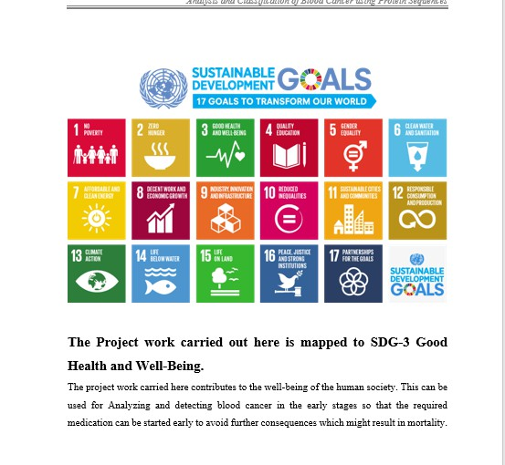
Project work mapping with SDG

Slide 16
Thank You

